Slide 1
Multiboards Solution

Slide 2


Slide 3
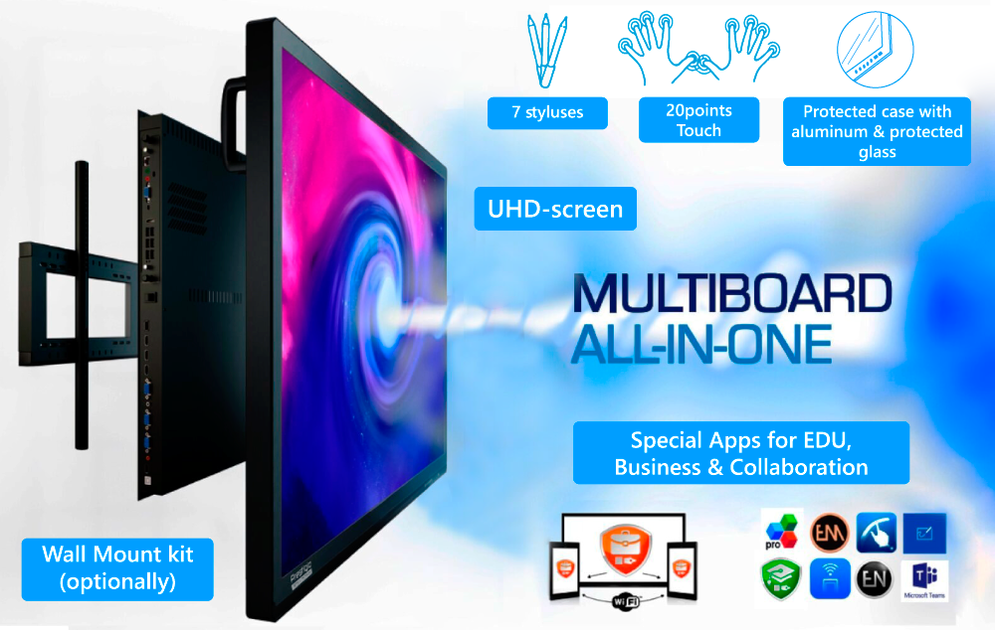

Multiboards
Interactive screen specially created to enhance processes in education, business, meeting rooms and other TVMS.
2 SERIES of MULTIBOARDS
PRIME SERIES MULTIBOARD - all in one comprehensive solution with integrated Windows PC, integrated OS Windows 10 Pro license and preinstalled multifunctional apps, additional accessories as MultiPen.
Ready from the box.
LIGHT SERIES MULTIBOARD with Android based PC, most popular Apps for the writing & mirroring. Affordable price point.
Windows PC optionally, OS Windows license optionally, multifunctional Apps optionally.

Slide 4
Prestigio Solutions MB LineUp, 2022’H1
PMB000L654 (Light Series)
UHD / Android 8.0 / 20 points multitouch / ARM A73+A53, 3GB, 32GB / PC Windows (optionally)
65”
PMB000L754 (Light Series)
UHD / Android 8.0 / 20 points multitouch / ARM A73+A53, 3GB, 32GB / PC Windows (optionally)
75”
PMB000L864 (Light Series)
UHD / Android 8.0 / 20 points multitouch / ARM A73+A53, 3GB, 32GB / PC Windows (optionally)
86”
PMB528L653 (Prime Series)
UHD, Windows 10 Pro / Android 9.0 / 20 points multitouch / Intel® Core™ i5 10th Gen, 8GB, 256GB / Independent Graphic Card
65”
PMB728L753 (Prime Series)
UHD, Windows 10 Pro / Android 9.0 / 20 points multitouch / Intel® Core™ i7 10th Gen, 8GB, 256GB / Independent Graphic Card
75”
PMB728L863 (Prime Series)
UHD, Windows 10 Pro / Android 9.0 / 20 points multitouch / Intel® Core™ i7 10th Gen, 8GB, 256GB / Independent Graphic Card
86”
PMB751G983 (Prime Series)
UHD, Windows 10 Pro / Android 8.0 / 20 points touch / Intel® Core™ i7 8th Gen, 16GB, 512GB / Independent Graphic Card
98”
PMB528K001 (PC for Light Series models)
PC 80 pin / with Intel® Comet Lake-U CPU i5 10210U 10th Gen / 8GB / 256GB
PC
PMB528K002 (PC for Light Series models)
PC 80 pin / with Intel® Comet Lake-U CPU i5 10210U 10th Gen / 8GB / 256GB, 3G & LTE module
PC

Slide 5
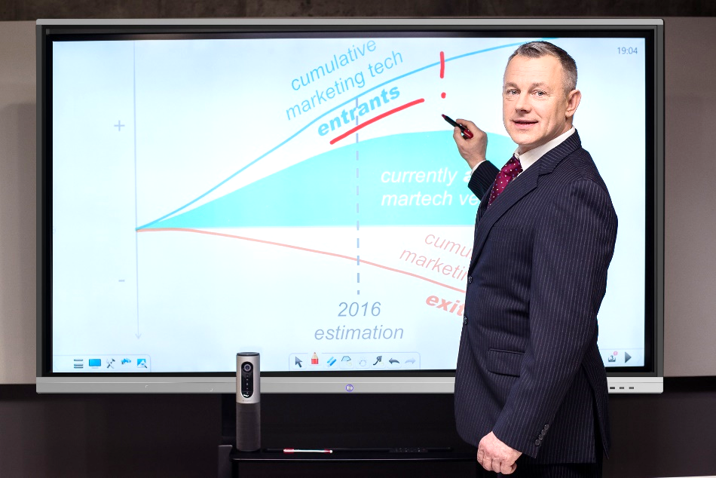
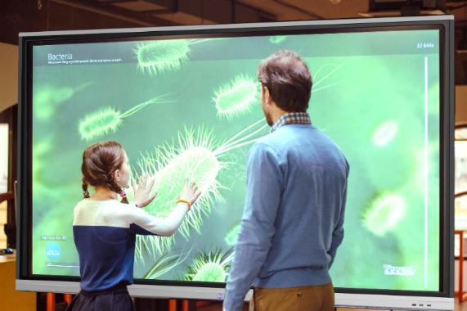
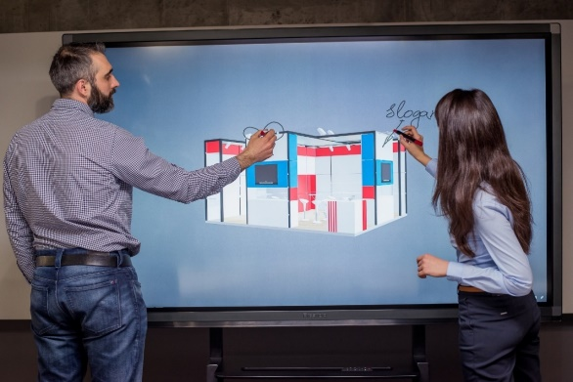



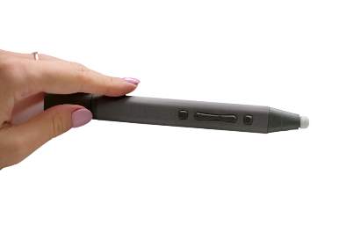



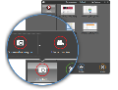
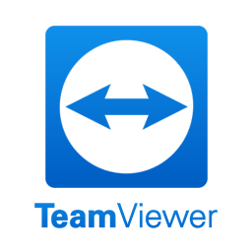
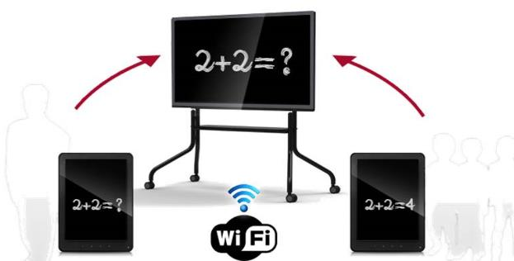



Windows 10 PC for Group Collaboration
Preinstalled apps for education and trainings
EDUCATE
PRESENT
COLABORATE
Exclusive user-friendly apps for screen sharing, mirroring, record
Cutting edge applications for collaboration

Slide 6

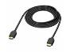


Choose your solution: MULTIBOARD OR…
Prestigio MultiBoard
Projector + PC + Software + additional equipment…
OR

Slide 7

Multiboards
USAGE SCENARIOS

Slide 8
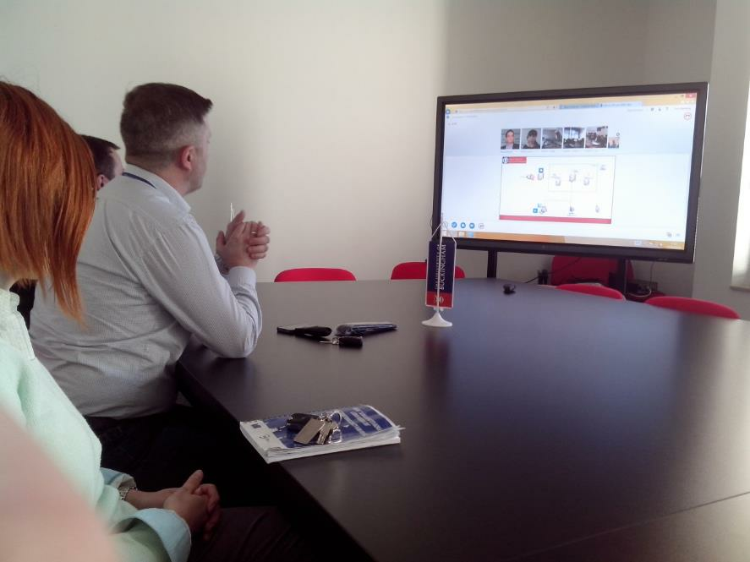
Scenario 1: meeting room
Key expectations:
Transform group productivity
Work in any room, minimal installation experience
Software included (for the Multiboards with integrated PC)
Engaging productive meetings
Easy to share / connect
Apps pre-installed & working offline
Prestige and positive impression from modern fiches

Slide 9
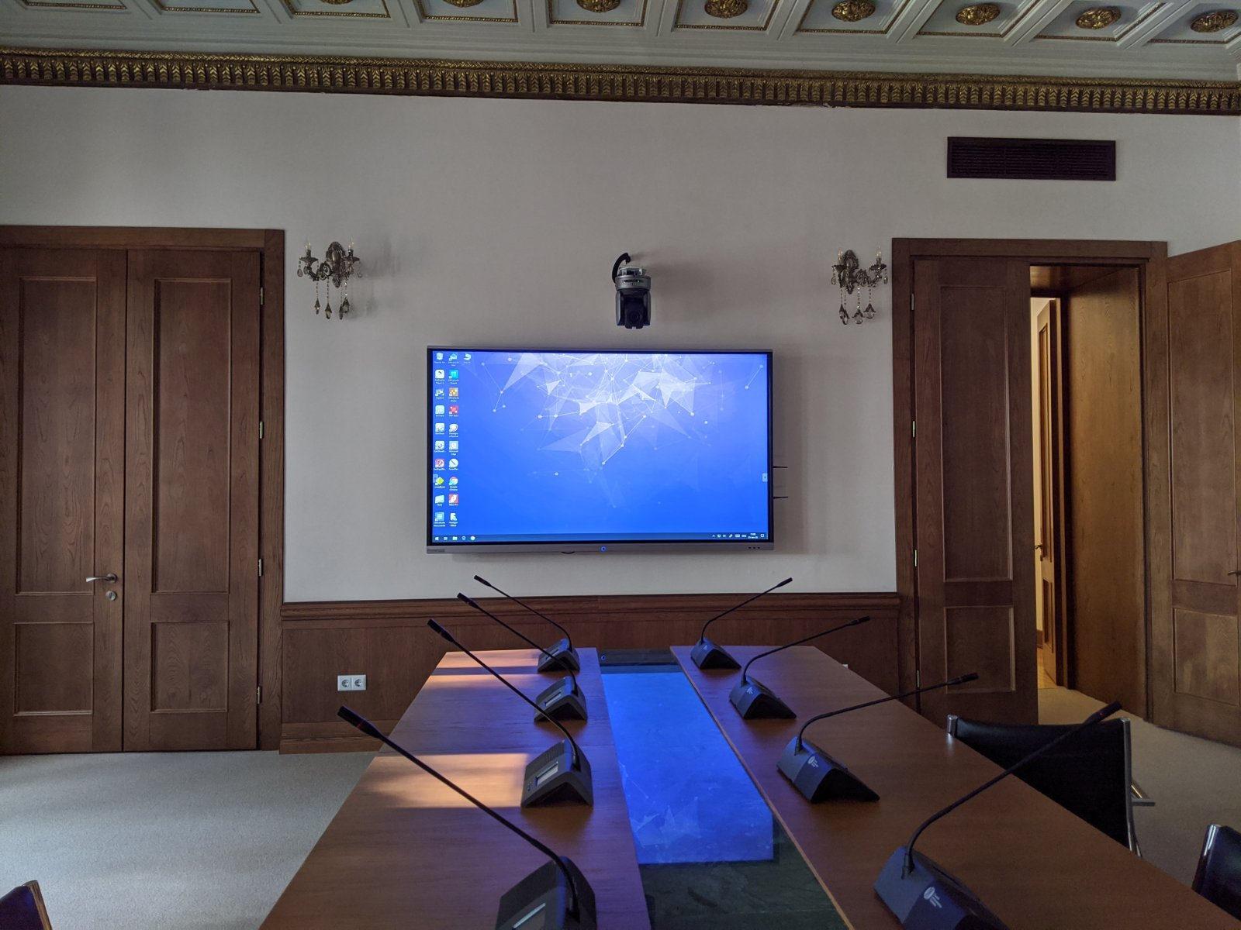
Scenario 2: conference hall
Key expectations:
Engaging remote meetings
(with Logitech collaboration Solutions)
2. Saves time
3. Easy to share / connect
4. Apps for the screen + room recording
(preinstalled with licenses)
5. Bright and clear picture even under day light

Slide 10
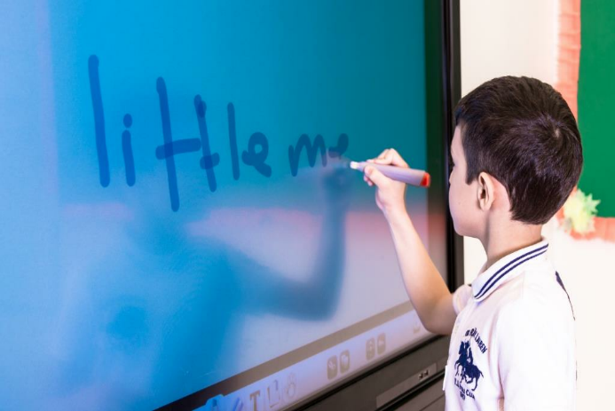
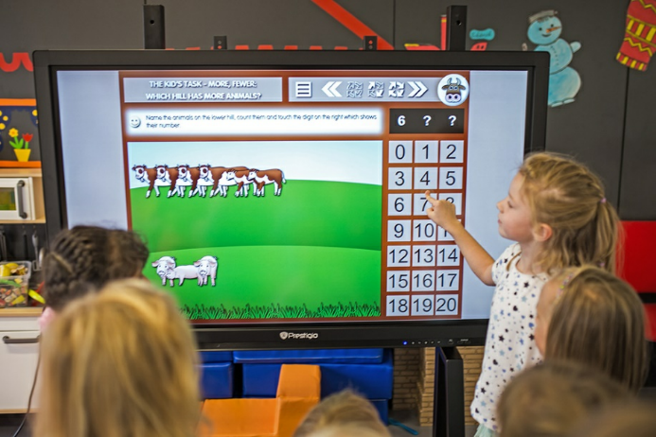
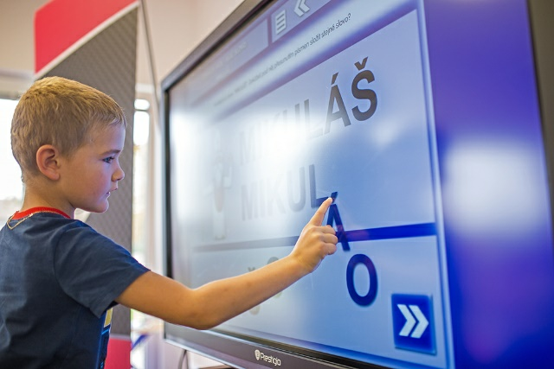
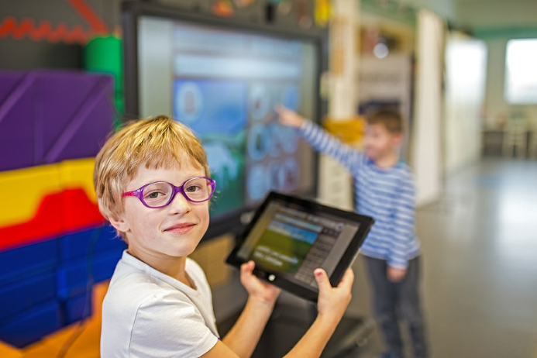
Scenario 3: classes, lecture halls
Key expectations:
Preinstalled easy to use software for education and collaboration
Engage the audience
Ready lessons with the preinstalled soft
Connect to students’ work places
Powerful Windows PC

Slide 11
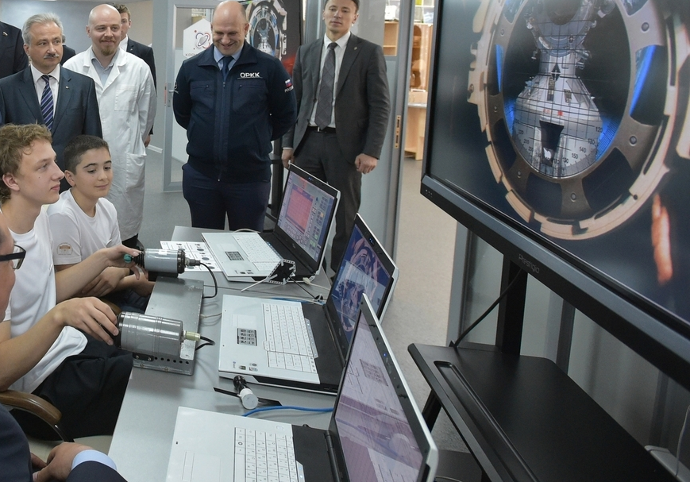
Scenario 4: control rooms
Key expectations:
Big screens ( 98” may be used as a video wall)
Remote control of the device via RS-232, ethernet, mobile apps
High picture quality
Touch and huge number of connection ports/options
Accessories for writing & connection included

Slide 12
Two types of Prestigio Solutions Multiboards
Characteristics | Prestigio Multiboard Prime Series | Prestigio Multiboard Light Series
Windows PC | + | (optionally)
OS Windows 10 Pro (license injected) | + | -
Preinstalled soft & multifunctional Apps | Full pack of applications | Limited
Smart pen / MultiPen (for ppt control, writing, drawing) | + | -
Lighting sensor | + | +
Integrated independent graphic card | + | -
Android version | 9.0 | 8.0
Set up touch or ports blocking from remote control | + | -
Mozabook Classroom license included | + | - (only with Windows PC)
Type C, HDMI, USB touch in front panel | - | +
Subwoofer | - | +

Slide 13
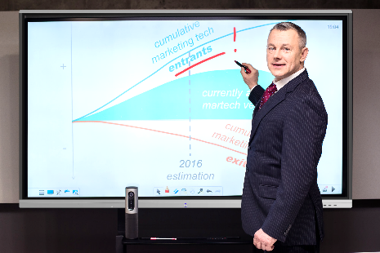
Multiboard Prime Series (with integrated PC)
DISPLAY | 3840×2160/ IR touch 10 points writing, 20 points touch
OS | Windows 10 Pro
WINDOWS PC | Intel® Core™ i5 (10th gen CPU 10500, 3.1GHz) / 8GB DDR4 / 256GB SSD for MB 65” Intel® Core™ i7 (10th gen CPU 10700, 2.9GHz) / 8GB DDR4 / 256GB SSD for MB 75”-86” Intel® Core™ i7 (8th gen 8700) / 16GB DDR4 / 512GB SSD for MB 98”
GRAPHIC CARD | Independent Graphic GTX1050Ti
EXTRA PC OS | Android
IN THE BOX | QSG, AC power cable, remote control, 6 Writing Pens (incl 2 Pens for writing double colors in parallel) & One Multy Pen, audio/USB/VGA cables, USB-driver stick, Wi-Fi antenna x 2, Warranty Card
65” 75” 86” 98”
Warranty period 2 years +1 year (free service)

Slide 14
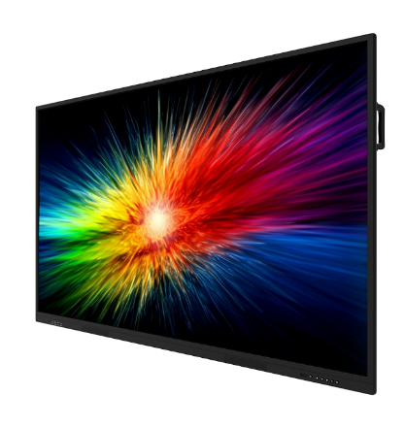
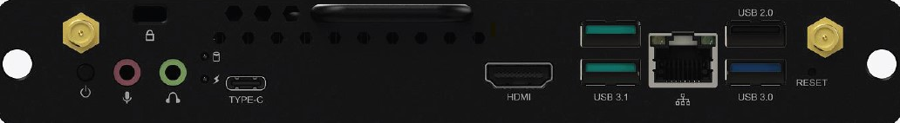
Multiboard Light Series (without integrated PC)
DISPLAY | 3840×2160/ IR touch 10 points writing, 20 points touch
OS | Android 8.0
EXTRA PC SPECS | ARM Cortex A73 Dual Core + A53 Dual core CPU/ RAM 3GB / ROM 32GB
PREINSTALLED SOFTWARE | App for writing included, App for mirroring included
IN THE BOX | QSG, AC power cable, remote control, 7 Writing Pens (incl 2 Pens for writing double colors in parallel), USB/HDMI cables, Wall Mount Kit, Warranty Card
65” 75”
86”
Warranty period 2 years +1 year (free service)
OS (compatibility) | Windows 11 Pro (trial)
INTERFACES | USB 3.1 x 2; USB 3.0 x 1; USB 2.0 x 1; RJ45 x 1; HDMI OUT x 1; USB 3.1 Type-C; Mic 3.5mm x 1; WiFi 802.11 (ac) 2.4GHz & 5GHz, TPM2.0 support
CPU / RAM / ROM | Intel® Comet Lake-U CPU i5 10210U 10th Gen ; RAM 8GB; SSD 256GB;
GRAPHIC | Intel® HD Graphics 6 series
PREINSTALLED SOFTWARE | Mozabook Classroom, mClass, OfficeSuite
PC Windows for Light Series
Warranty period 1 year
Full specs are available on | Prestigio Webpage, IT4 Profit, DataSheet, QSG,

Slide 15

ACCESSORIES

Slide 16
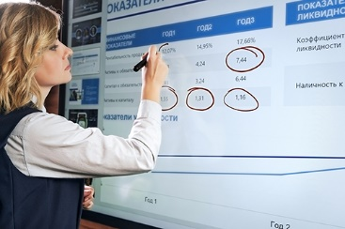
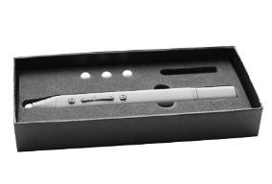
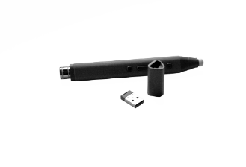
MULTY PEN (in the package by default)
MULTY PEN | Specially done for writing functions, slides playback & hand writing during presentation.
OPTIONS | Easy connection Different colors writing Communication with Power Point (switching On / Switching Off, comments writing, Slide Up / Slide Down) during presentation Zooming
SIZE / MM | 162x16x17
NET / G | 30g
PRICE | FREE with Prestigio Multiboard (with Windows PC)
* Applicable for all Prestigio Multiboard models, except Multiboard Light Series

Slide 17
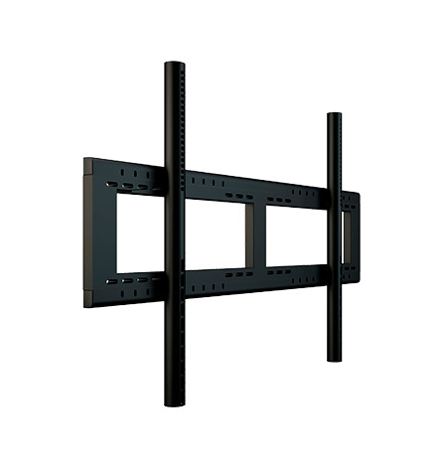
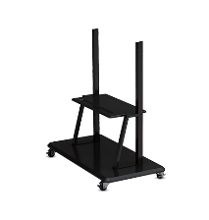
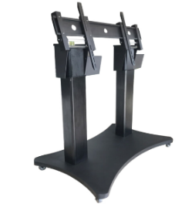
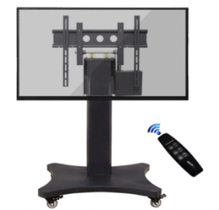
Stands & Wall-mounts
Electro Stand
MB Model compatibility | 55-98"
Description | Wall Mount Kit for all sizes. Must be ordered along with PMB as standard option. Not included in the package. | Stand for all sizes. Features roll wheels to move freely & shelf to lay accessories. To be bundled with Wall-mount kit PMBWMK.
PMBST03E
Maximum load: 180 kg
Electric lift range: 1250-1650MM
PMBST04E
Maximum load: 100 kg
Electric lift range: 560 MM
Remote control electric up and down
Remote control electric 90 degree tilt angle automatic adjustment
Exquisite four wheel with brake medical mute casters about 360 degrees free rotation
High quality cold rolled sheet, aluminum alloy and industrial plastic manufacturing

Slide 18
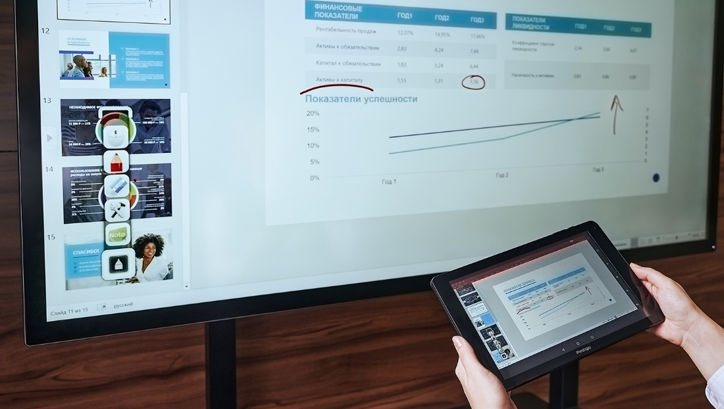

SOFTWARE FOR MULTIBOARD WITH PREINSTALLED WINDOWS PC

Slide 19




Multiboard Software Opportunities Apps features
APP #1 – Connect
(license is included & FREE with Multiboard)
MultiBoard remote management from a mobile device
Mobile device mirroring
Live Camera streaming
Multimedia streaming and transfer from a mobile device (-photo / -video, etc.)
App #2 – Note 3
(license is included & FREE with Multiboard)
Integrated presentation timing option and web surfing environment
Presentation notes reserving function
Desktop screenshots capturing option
Built-in drawing tool for notes and mock-ups compatible with any apps
Use pre-se drafts on math, chemistry, physics and foreign languages with modern universal tools for evident studying
App #3 – Prestigio-Addreality
( 1 month license is included)
Get your personal Digital Signage universal tool
Create your own Digital Signage network content ,manage and distribute it easily
Create your targeted ads campaign with interactive scenarios of any complexity
Get wide and wise ad campaigns reports, including deep analytics in buyer’s portrait and auditoria reach in one system
App #4 – Capture
(license is included & FREE with Multiboard)
Record sound and video on MultiBoard screen
Save your tutorials, meetings and webinars, Skype sessions
Connect the external camera to record your conversations
Use video editor with user-friendly options
App #5 – OfficeSuite
(basic functionality FREE with Multiboard)
Create and edit any type of office documents and attachments.
Synchronize between devices with different OS
Convert PDF to Word, Excel, or ePub
Scan your physical documents to PDF via your devices' camera
Markup with digital signatures
App #6 – EasiSign
(license is included & FREE with Multiboard)
Create your own company’s anniversary, birthday greeting cards –
Share your holiday and try handwritten text messages recognition
Make a funny selfie with External video camera support option
App #7 – EasiShow
(license is included & FREE with Multiboard)
- Make your own non-standard presentations possibility of two hands media zooming, rotating and relocating
App #8 – mClass
( 6 licenses are included & FREE with Multiboard)
* Applicable for all Prestigio Multiboard models, except Multiboard Light Series

Slide 20
Meeting and Education software
PMBAMT100: license to manage the App & users
PMBAMS100: user license
Set up your business trainings and tutorials
Unite some groups via wireless technology
Stream your MultiBoard screen to notebooks, tablet PCs and mobile phones of your attendants to any operating systems
Broadcast your video via network
Manage your devices remotely from Multiboard
Share your distant screen with another participants
Control the connected devices apps remotely
Stream and get the files from the connected devices and combine them into united workflow
Easily set the training sets
Share one screen together easily
Display several screens connected to your MultiBoard

Slide 21
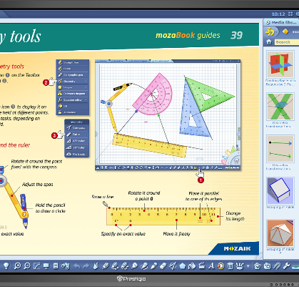

MozaBook: Whole school library in Multiboard
DIGITAL COPYRIGHTED LIBRARY
Use articles, images, 3D views, apps and other materials from mozaBook to create interactive lessons on Math, Geography, Chemistry, Physics, Biology, History, Languages and many other disciplines.
OPEN FOR DIFFERENT SOURCES
Combine different materials and sources to create an unforgettable interactive lesson. If mozaBook library is not enough upload your PDF textbook, pictures and videos.
SHOW, INTERACT, PLAY
Simple mozaBook features allow you to present with visuals, write in digital notebooks and explain with dedicated games.
Opening the digital content inserted into the books;
Opening 3D scenes in the media library;
Opening videos in the media library;
Opening tools and games;
Teachers can create dynamic presentations for any school subject on the interactive board and use amazing interactive tools, 3Ds, videos and other content. They can create exercises and assignments for students.
DESCRIPTION | One year subscription. Dedicated educational software for interactivity, recommended for Prestigio MultiBoards. School library of publications, images, 3D views, games and tools. One license works on one Prestigio Multiboard.
FULL LICENSE | FULL 1 Year usage license of Mozabook Classroom for FREE with Prestigio Multiboard (with Windows PC only)
RELATIONSHIPS | Prestigio is an Official OEM partner of Mozaik Education.
Watch mozabook video
* Applicable for all Prestigio Multiboard models & PC Windows (PMB528K001), except Multiboard Light Series

Slide 22
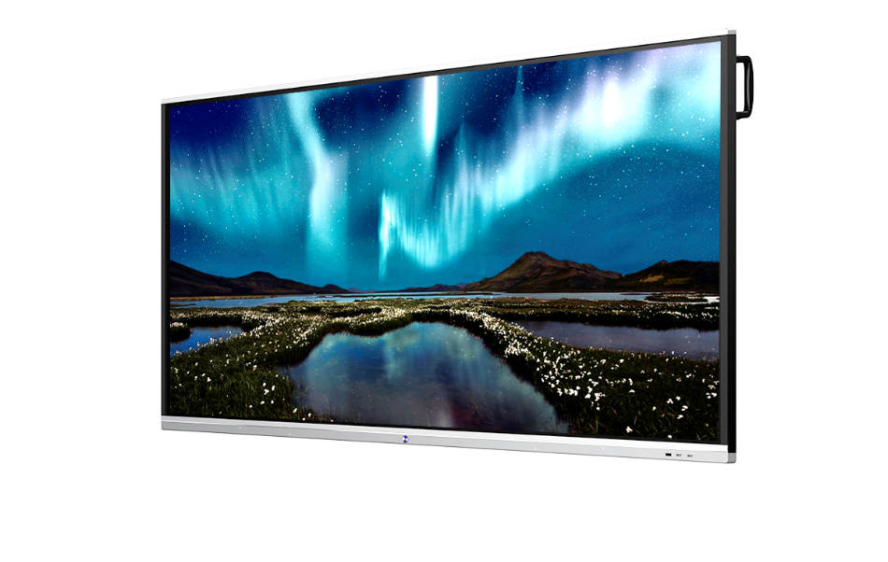
How to compare Multiboards with others?
During a comparison our products with competitors, please make absolutely sure that SAME groups of the goods are compared!
Pay attantion during the comparison:
1) Type and specification of the screen (at least main parameters)
2) Inbuild PC specification
- Check if competitor's price includes PC
- Check the specification of the PC
3) Preinstalled software
- Check if competitior's price includes software
- Check the license model (long life license or time limited) it could influence the total cost of ownership
- Check if software works on-line or offline modes
4) Check if there any accessories
5) Do they have all necessary certificates already?.
6) OS Windows injected? Version of OS Windows?
7) Price with VAT or without? Price local or in China no name?
8) Do they have local service centers? Do they have local office & warehouse or extra delivery charges will appear?
Our products win a fare comparison in 100% cases!

Slide 23
Your reliable partner
in solutions for business and education
Thank you!

